Slide 1
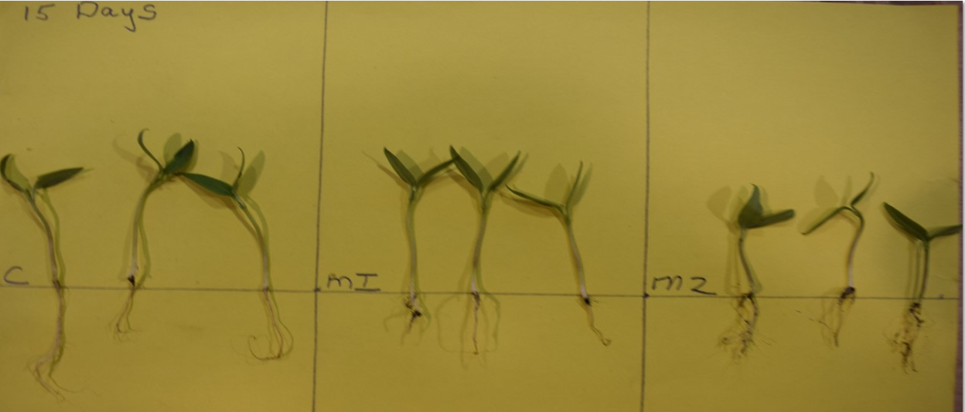
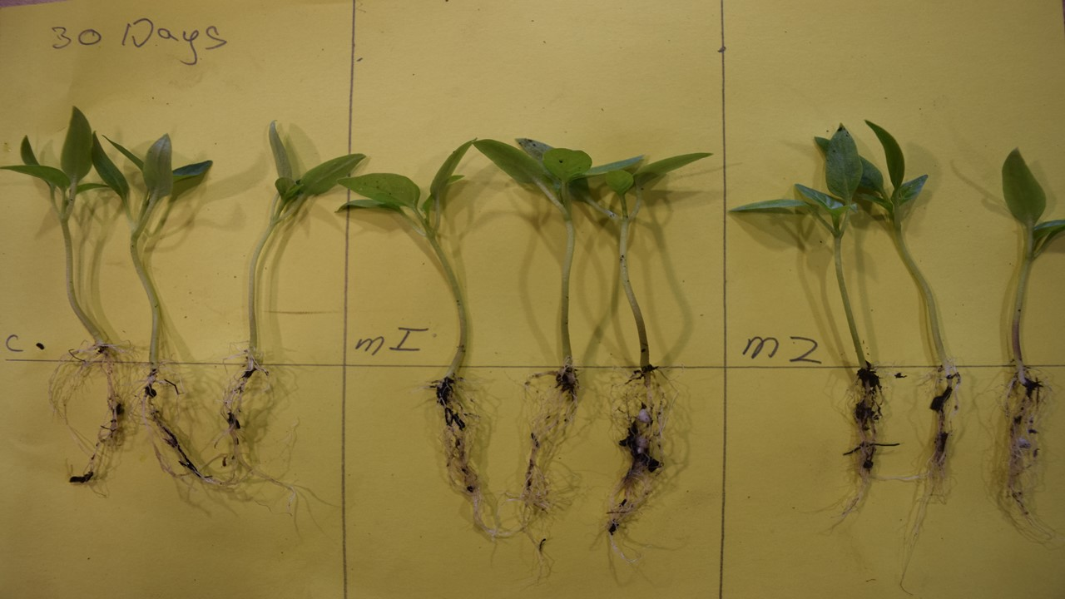
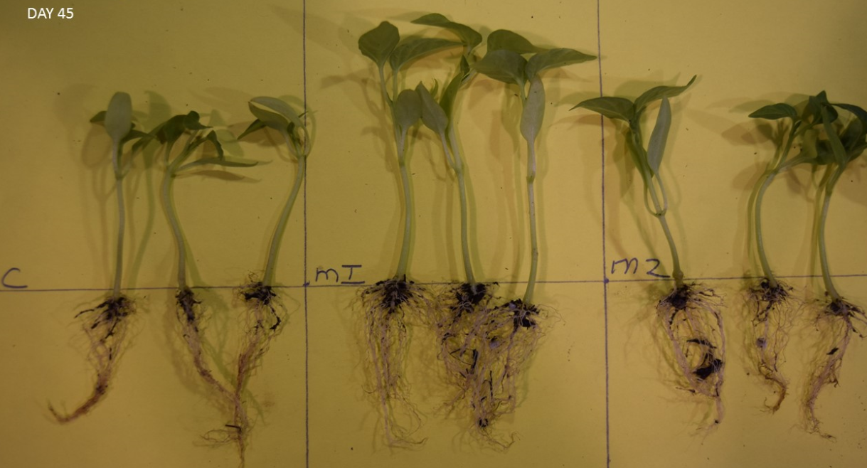
EFFECTS OF MYCORRHIZAL INOCULATION ON PEPPER PLANT GERMINATION AND SEEDLING ESTABLISHMENT
Caleb Messler and Cameron Hill, Plant Science Division 6
Parkside High CTE Horticulture. FFA Wicomico Maryland
Question
Results
Findings
Studies have shown that endo- mycorrhiza provides protection against pathogens and stimulates productivity of crops. There has been both few studies or adoption in the greenhouse transplant
production setting that tests endo- mycorrhizal efficiency related to vegetable plant seed germination, emergence, and seedling establishment.
As hypothesized the application of mycorrhiza to seed had significant contribution to root formation and height. After 45 days there was significant increase in root density and plant height. The seed soaked mycorrhiza plants compared to control: + 50% in root length and + 30% in height. The incorporated mycorrhiza plants improved + 25% root length and + 20% height. There was no significant difference in emergence time or germination rates.
Plants Measured at 15 Days
Procedures
Environment:
Study was conducted in Jan/Feb in greenhouse Zone 7B with 70° F. ambient temperature benches with heat mats at 85° F.
Hypothesis
There will be an increase in height root length and germination rate of the mycorrhiza-treated seeds.
Discussion
Established Seed:
Improving plant development from seed can contribute improved time savings and profits for growers. Studies to investigate seed mycorrhiza soaking should be investigated with other plants.
Design
Three Replicates
Control Seed stratified for 2 weeks. Presoaked in H2O for 8 hours. 40 seeds placed in cells. Placed on germination mat.
Study Seed: Pepper (Bell) Yankee
Treatment
M1 Seed stratified for 2 weeks.
Presoaked in mycorrhiza 2 oz./gal. for 8 hours. 40 seeds placed in cells. Placed on germination mat.
C Green H2O Presoak
M1 Red Mycorrhiza Soak
Plants Measured at 30 days
M2 Blue Mycorrhiza Incorp.
M2 Seed stratified for 2 weeks. Presoaked in H20 for 8 hours. Seedbed germination mix incorp-orated mycorrhiza 1 lb./per yd 3. 40 seeds placed in cells. Placed on germination mat.
Measurement
Plants measured for height, root length and germination at 15, 30 and 45 days.
Plants Measured at 45 days

