Slide 1
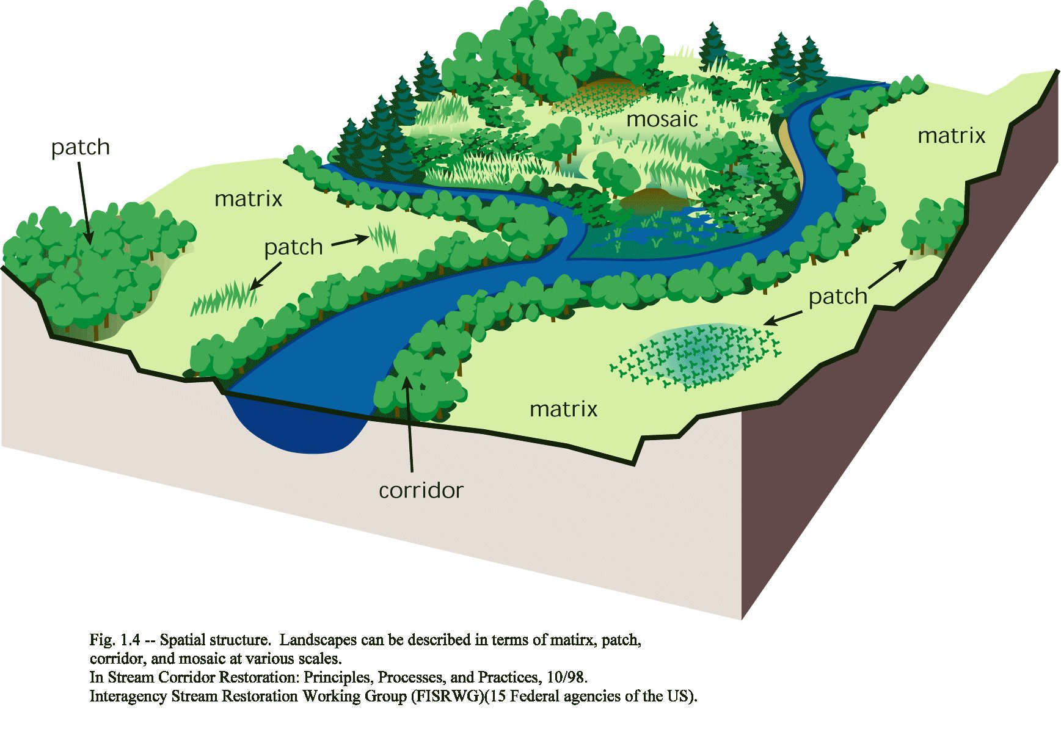
Stream Corridors/ Floodplains
Important for….

Slide 2
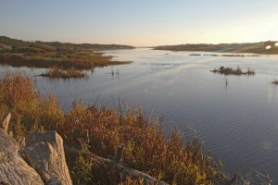
Water
Quality

Slide 3

Flood Storage

Slide 4
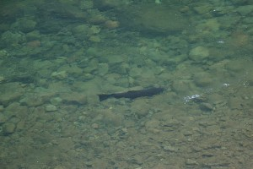
Habitat

Slide 5
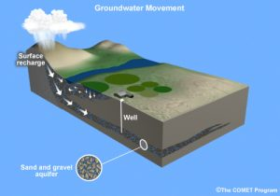
Groundwater Recharge

Slide 6
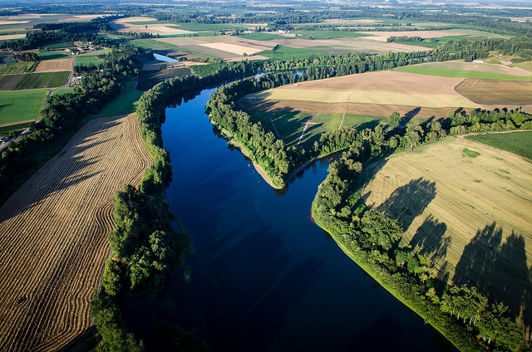
Food
Rich Fertile Soils

Slide 7
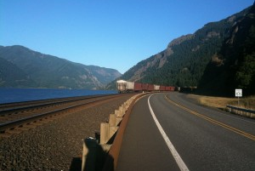
Transportation

Slide 8
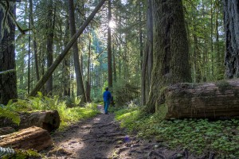
Culture
Recreation

Slide 9
Poor Stream Corridor and Habitat

Slide 10
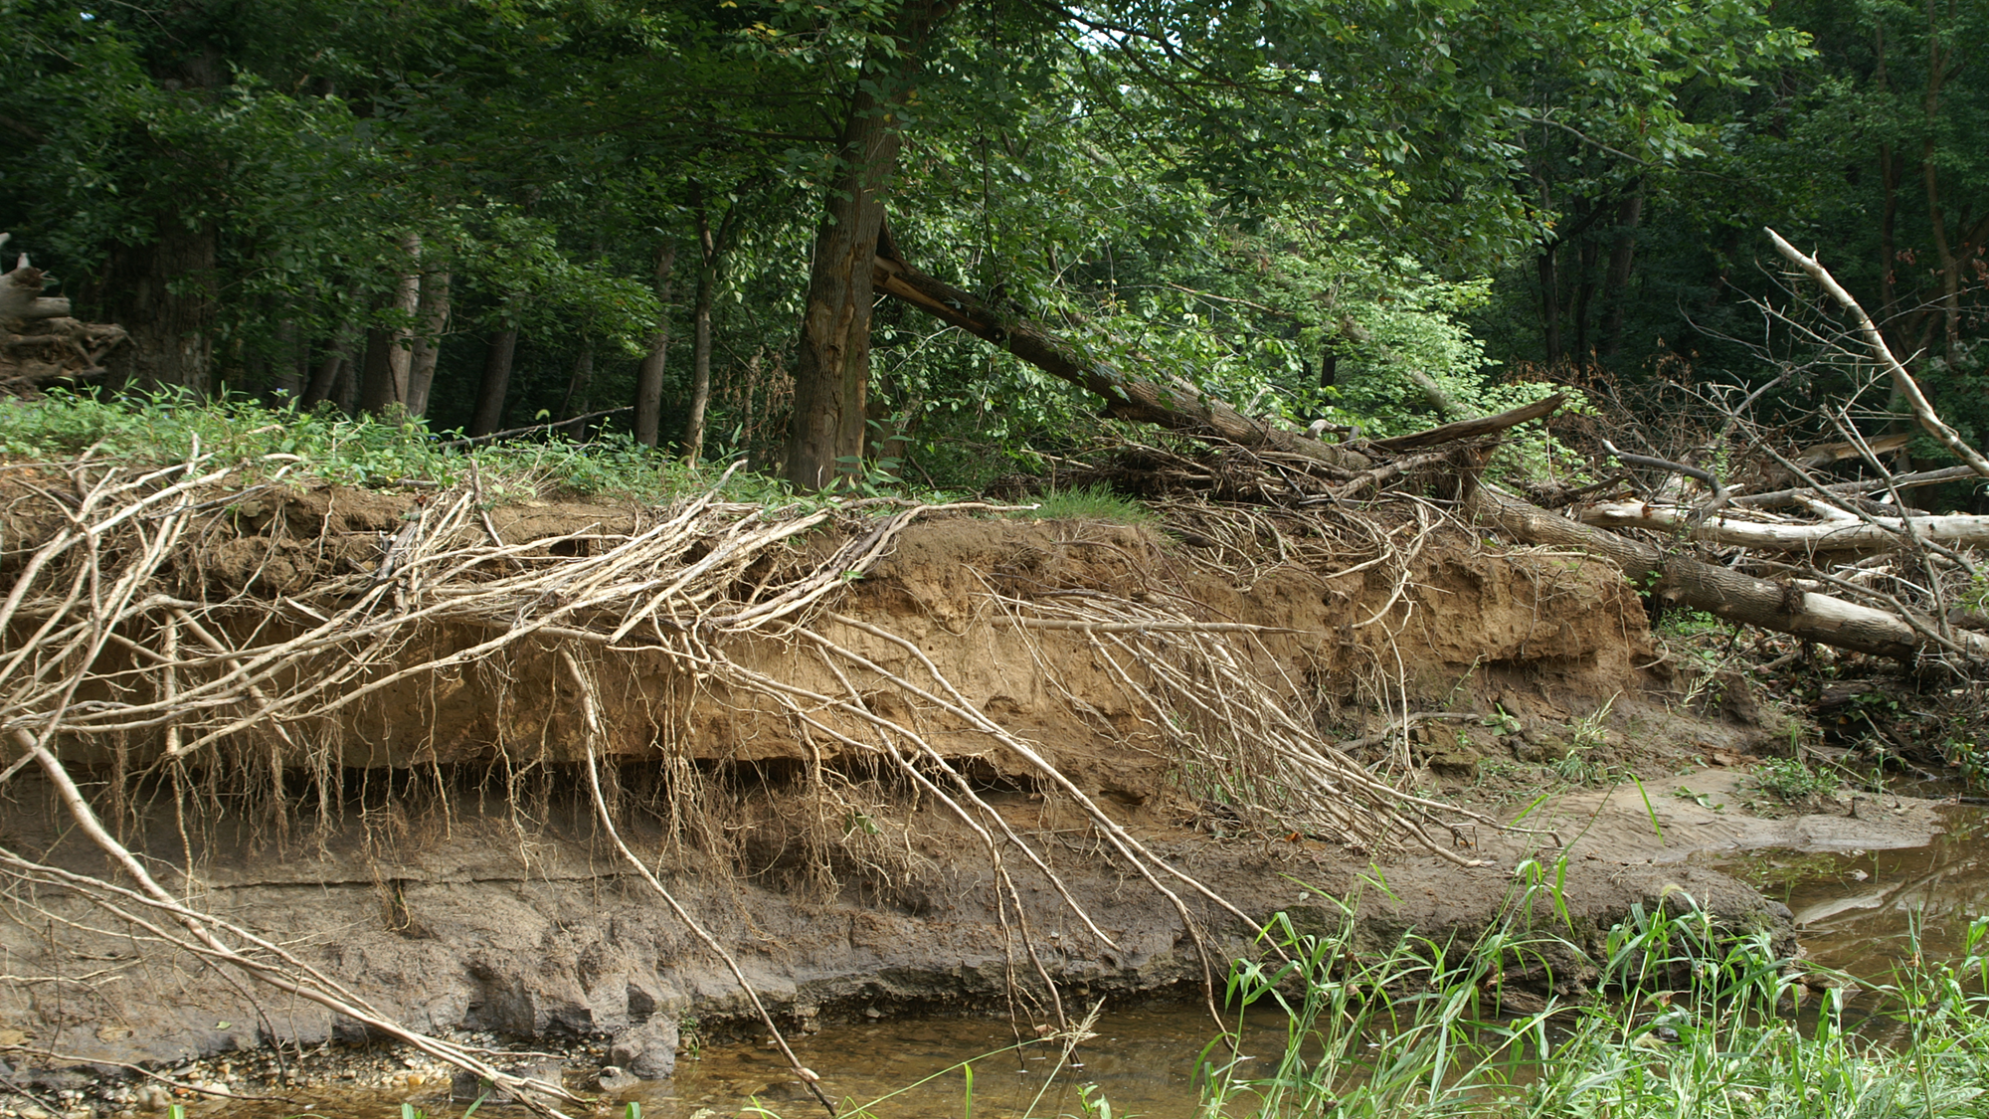
Floodplain Vegetation
Lacking

Slide 11
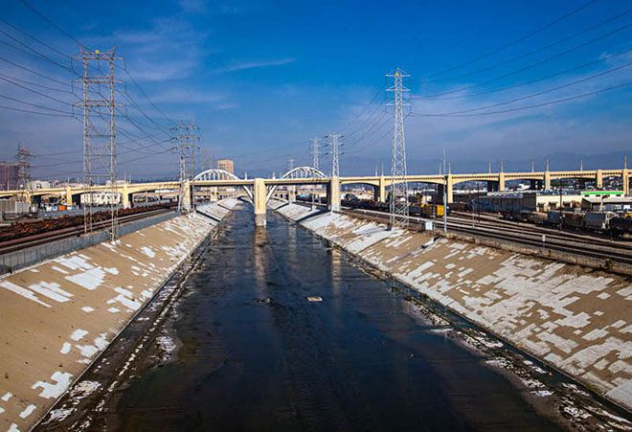
Channel Alteration

Slide 12
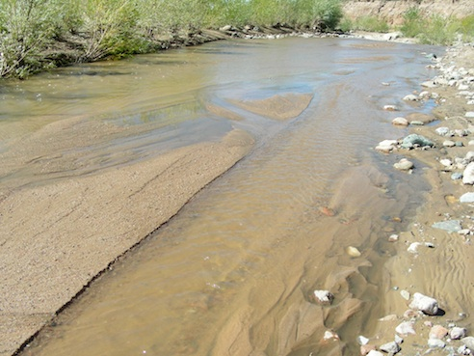
Embeddedness:
Lack of stone/ cobble

Slide 13
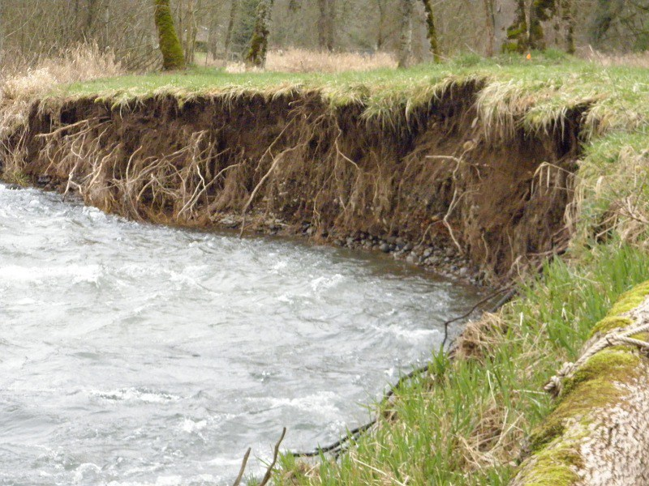
Erosion

Slide 14
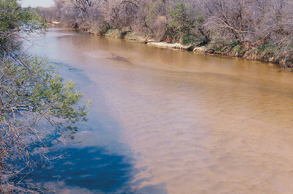
No attachment for
macroinvertebrates

Slide 15
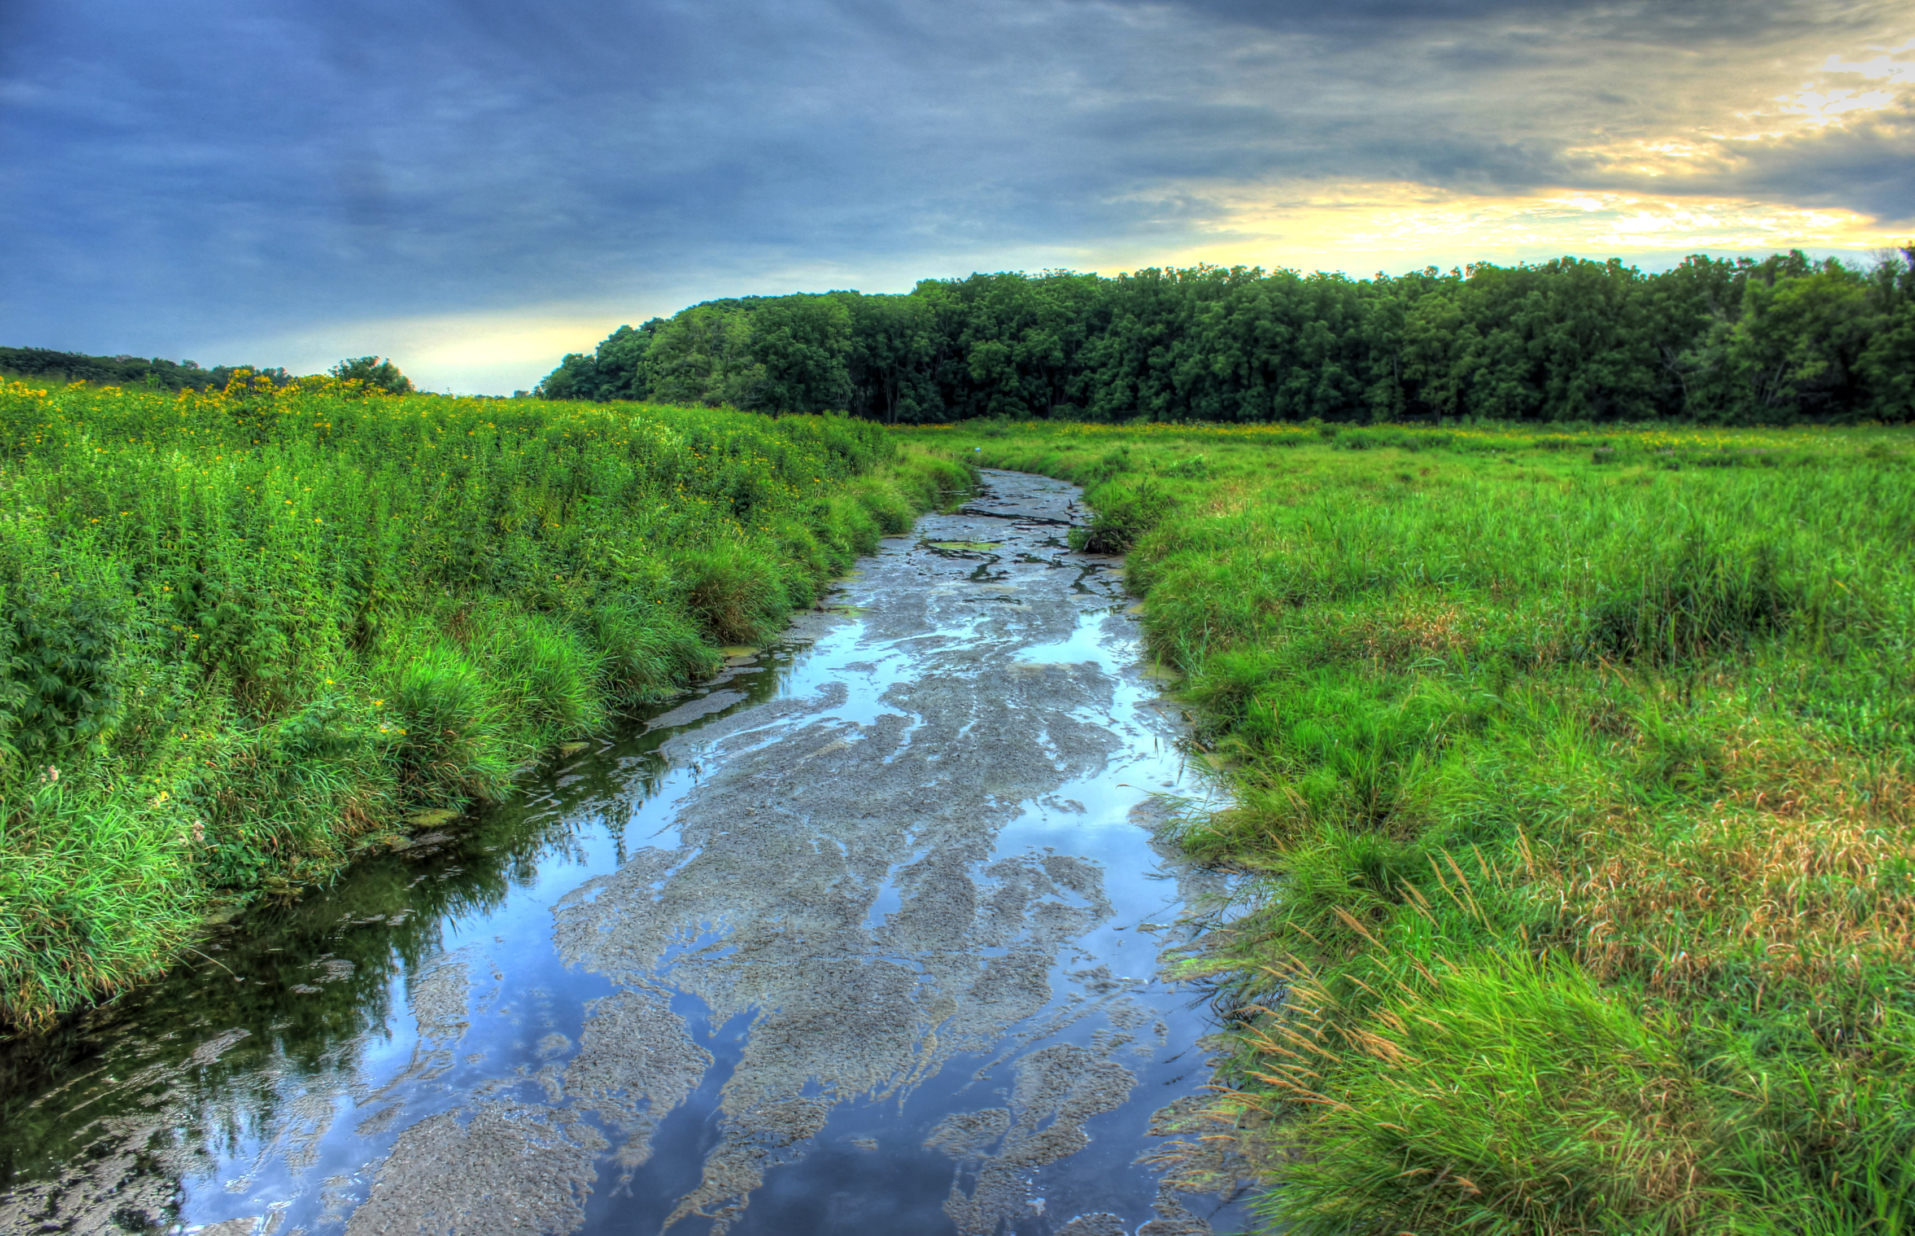
No Shelter for fish

Slide 16
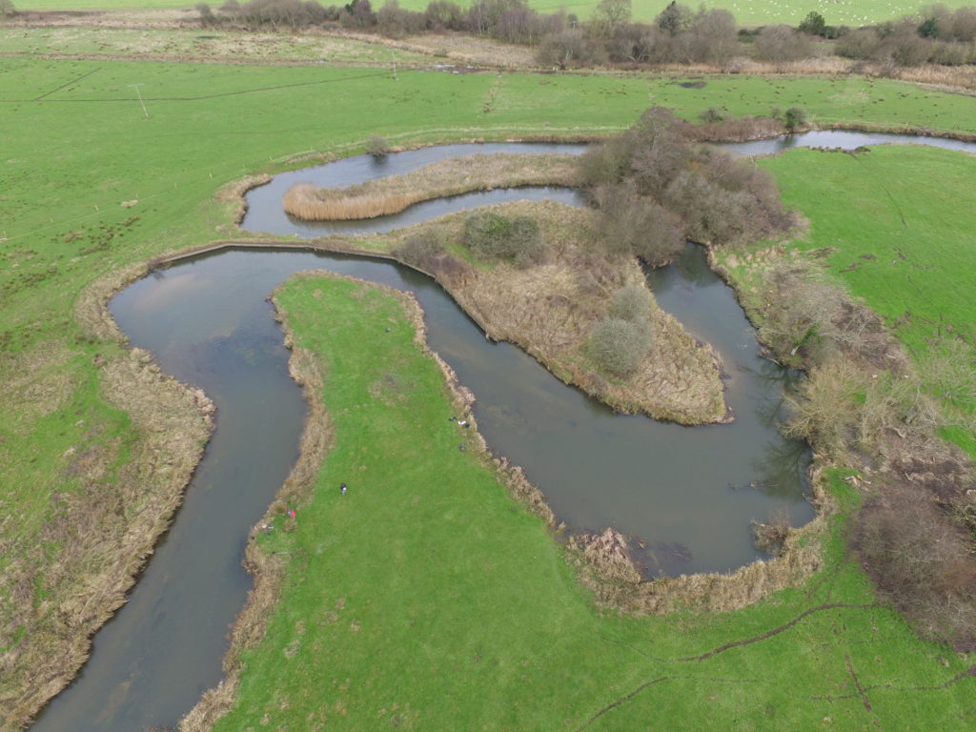
Lack riparian buffer width

Slide 17
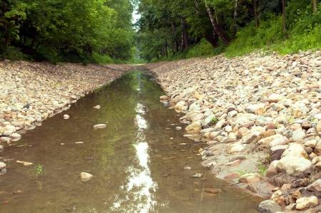
Lack of various velocity and depth

Slide 18
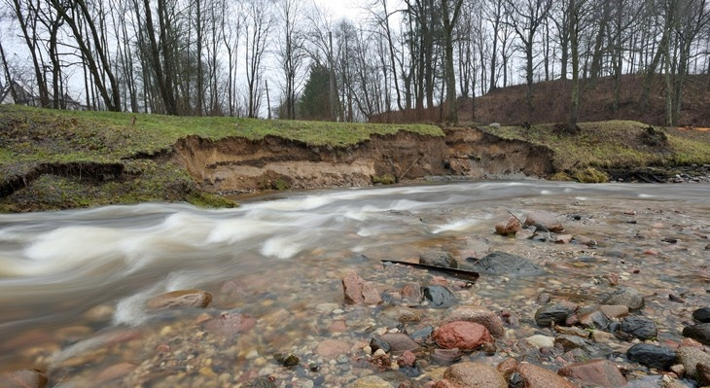
Lacking bank stability

Slide 19
Excellent - Stream Corridor
Factors

Slide 20
Floodplain Vegetation

Slide 21
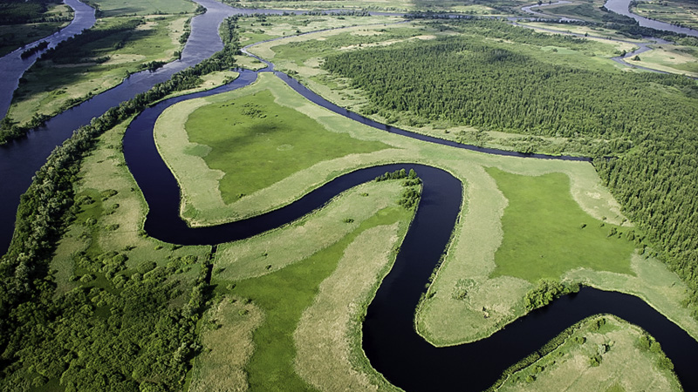
Channel formed by natural processes

Slide 22
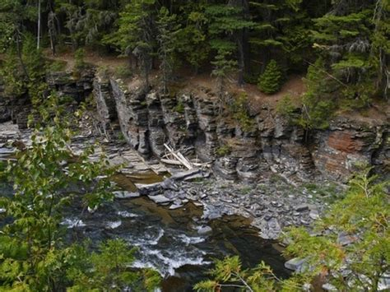
Embeddedness
Rocks and cobble cover stream bed

Slide 23
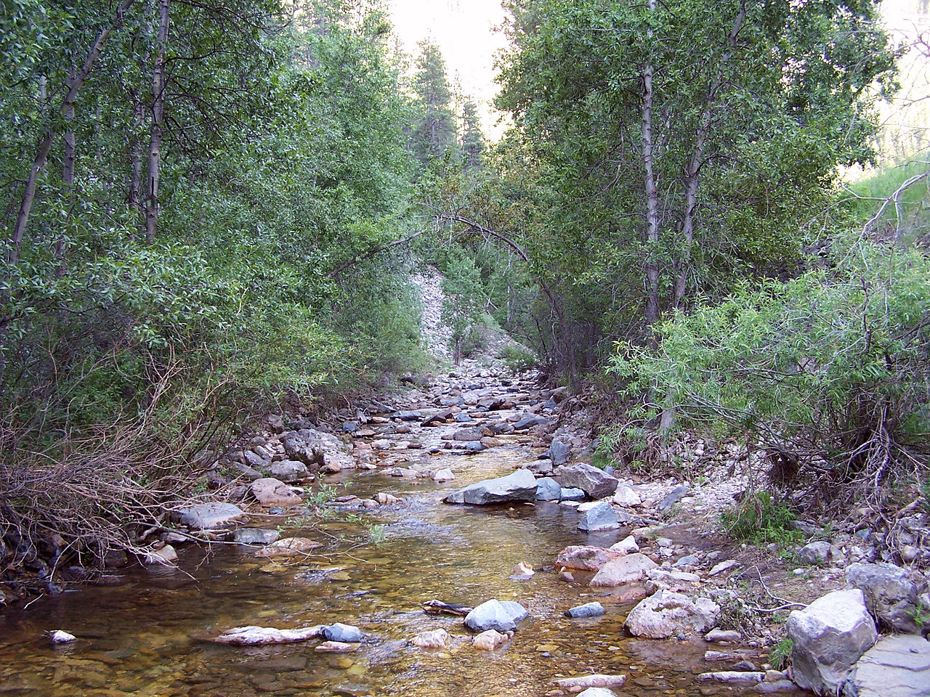
Erosion
Banks slightly above water

Slide 24
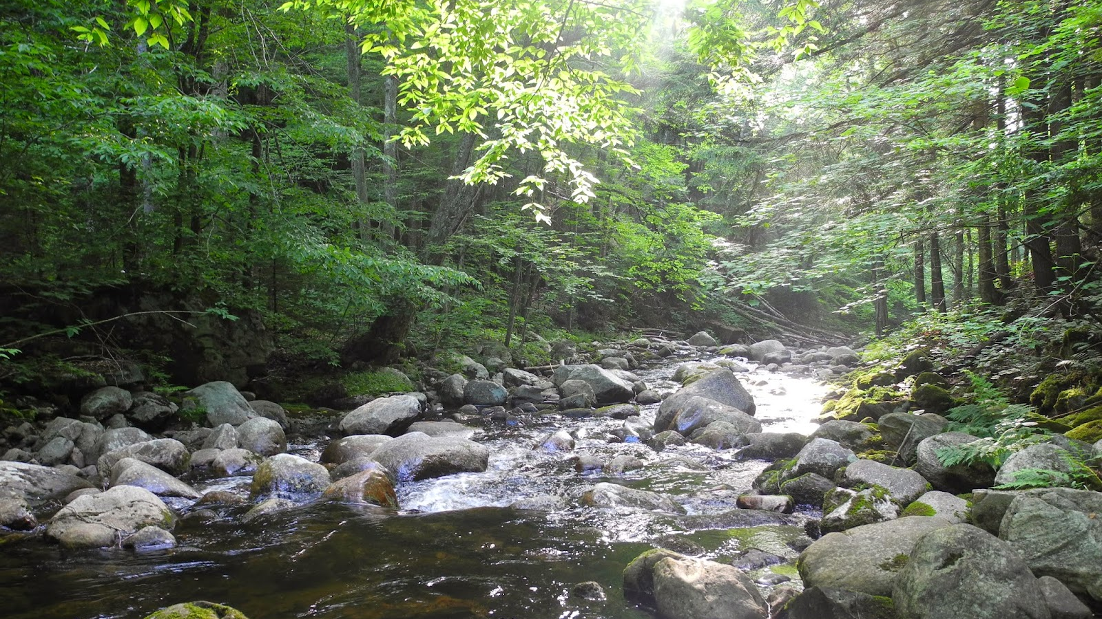
Macroinvertebrates
Attachment Sites

Slide 25
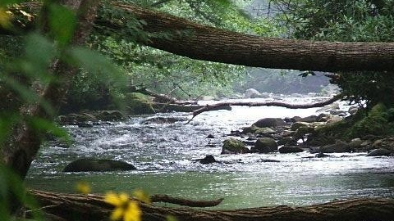
Shelter for fish
Shelter for Fish

Slide 26
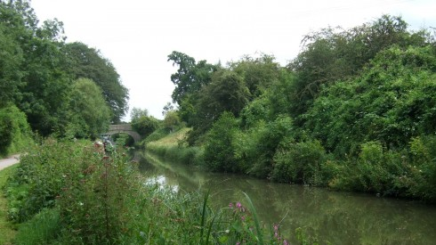
Riparian Buffer width
Extended Riparian Width

Slide 27
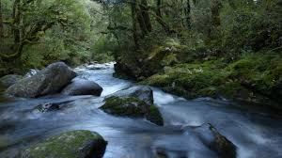
Bank Stability
Large Rocks-Vegetation

Slide 28
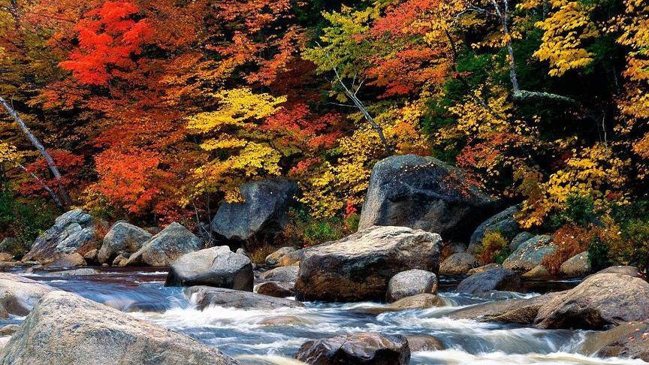
Velocity and depth.
Varying velocity and depth

Slide 29
Stream Bed/ Habitat/ Flood Plain
Mitigation

Slide 30
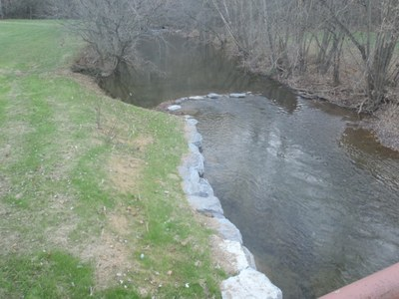
Anna Smith

Slide 31
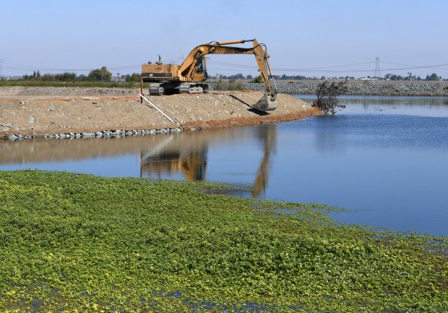
Caleb Messler

Slide 32
Kimali Sierra

Slide 33
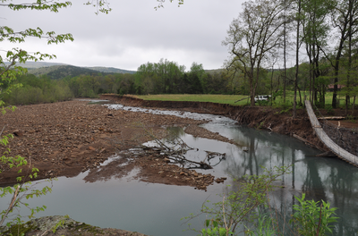
Gabrielle Baily

Slide 34
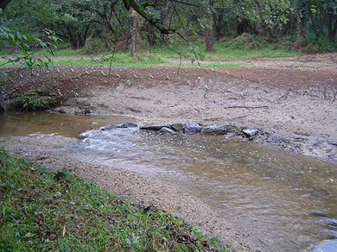
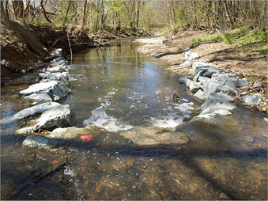
Cameron Hill

Slide 35
Amya Holbrook

