Slide 1
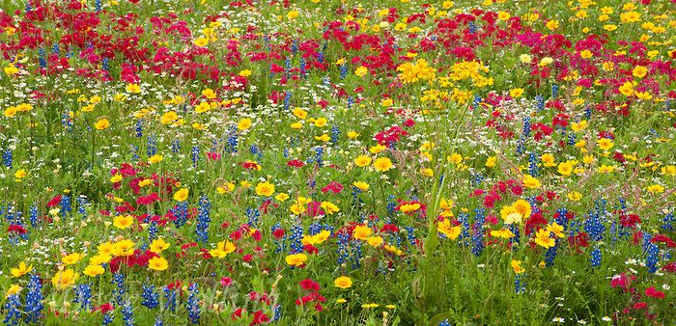
Parkside High
Environmental Action
Pocket Meadow

Slide 2
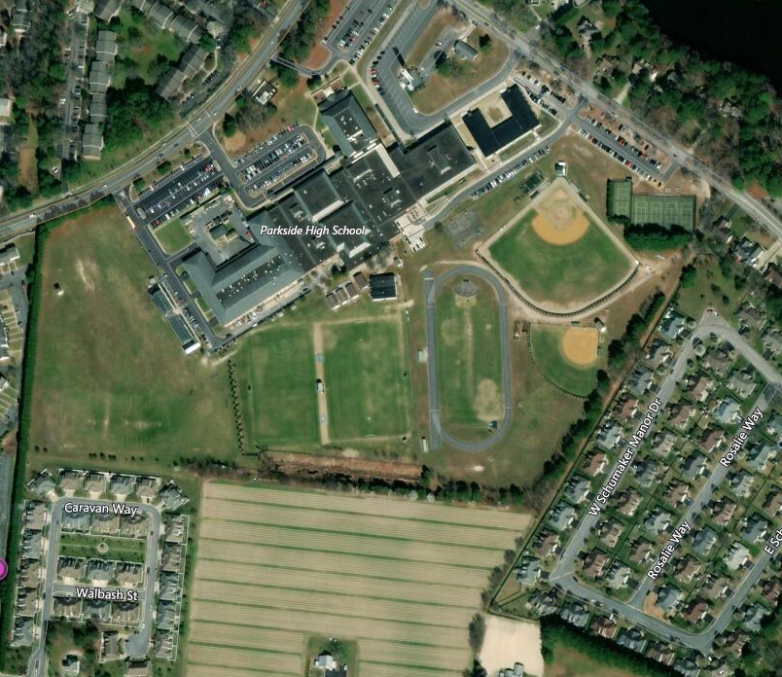

Slide 3
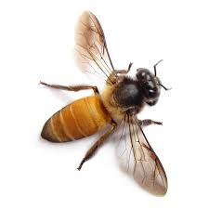
ISSUE:
21 ACRES GREEN MONOCULTURE
AESTHETICS
HERBICIDE
RUNOFF
LACK OF SHELTER FOOD AND FORAGE

Slide 4
YES-WE CAN
INTEGRATE ECOSYSTEM SERVICES
IN PLAYING FIELD ENVIRONMENT

Slide 5
Pocket Meadow Mission
Improve Aesthetics w/ Plant Diversity
Improve Habitat w/ Wildlife Protection and Forage
Mitigate Runoff w/ Deep Rooted Plants
Decrease Inputs w/ Less Fertilizer/ Chemicals

Slide 6
Phase 1:Three Meadow Pockets
GOAL: (1) EVALUATE MEADOWING PRACTICES (2) SEED SELECTION
1
3
2

Slide 7
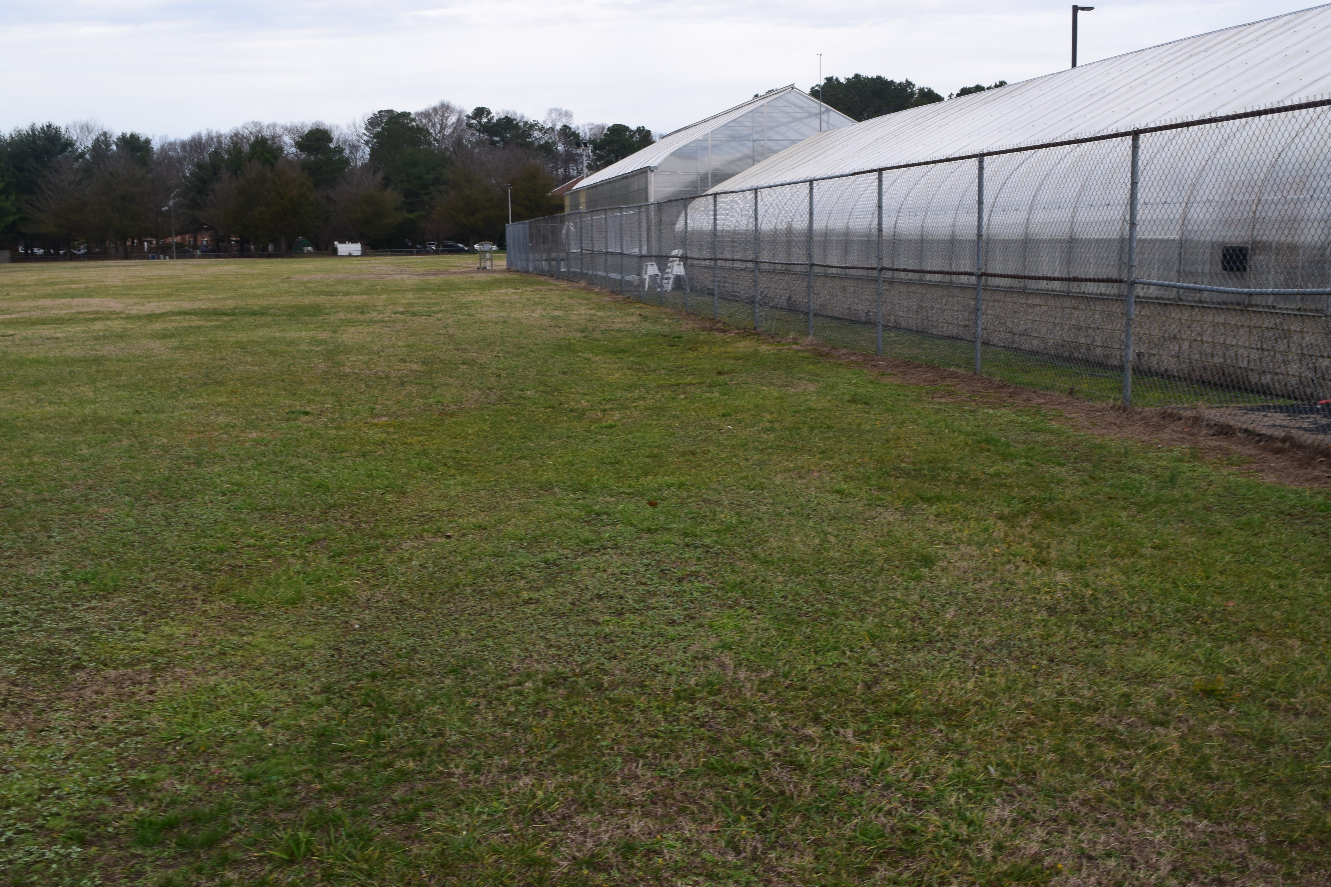
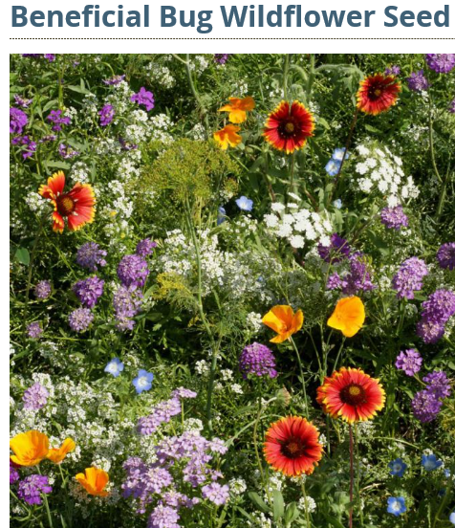
POCKET 1 120FT X 30FT
ESTABLISH AREA – SUMMER PLOW/ FALL PLOW
SEED – FALL SOW

Slide 8
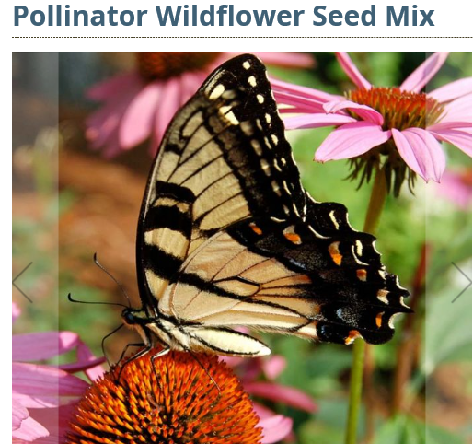
POCKET 2 120FT X 30 FT
ESTABLISH AREA- SOLARIZATION- SUMMER 2019
SEED – FALL SOW

Slide 9
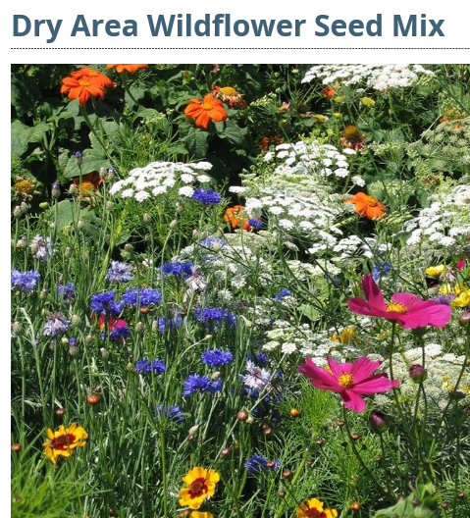
POCKET 3 120FT X 30FT
ESTABLISH- PLOWING SUMMER 2019
SEED –FALL SOW

Slide 10
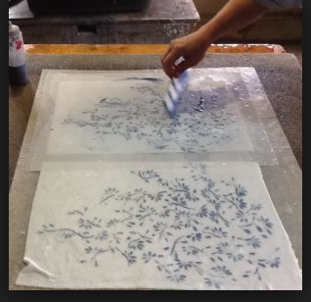
EDUCATION LINKS
Meadow
Art and Photography

Slide 11
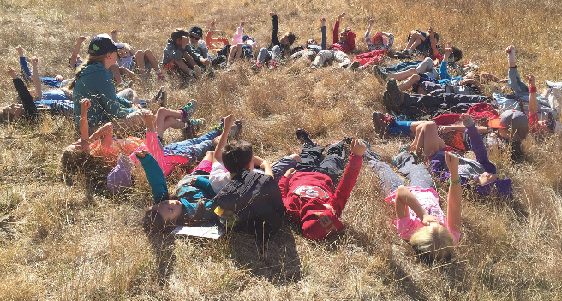
Observations
Research
Connections

