Slide 1
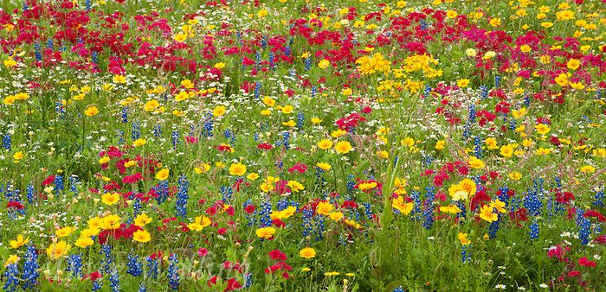
Parkside High
Environmental Action
Improve Fall Pollinator Forage

Slide 2
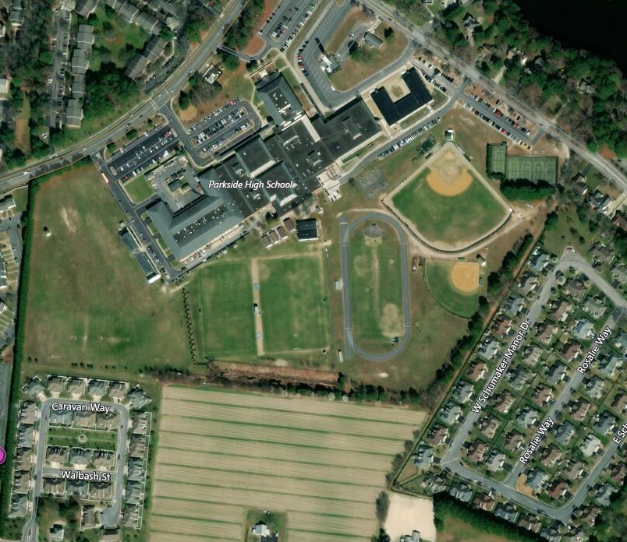

Slide 3
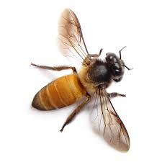
ISSUE:
21 ACRES GREEN MONOCULTURE
LACK OF PLANT DIVERSTIY
LACK OF SHELTER FOOD AND FORAGE
FOR POLLINATORS
ESPECIALLY IN FALL SEASON

Slide 4
CAN WE SUPPORT
POLLINATORS ?
YES-WE CAN
INTEGRATE 200 NATIVE PLANTS THAT
BLOOM DURING FALL

Slide 5
POLLINATOR FALL FORAGE
Improve Aesthetics w/ Plant Diversity
Improve Habitat w/ Wildlife Protection and Forage
Improve Fall Nectar and Pollen Sources
Improve support for native bee diversity

Slide 6
FALL PLANTING SITES -200 PLANTS
3
1
2

Slide 7
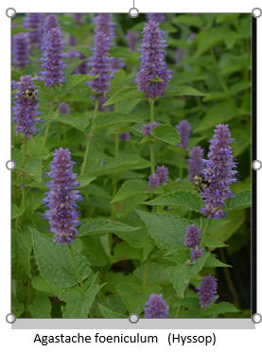
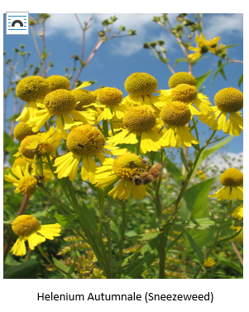
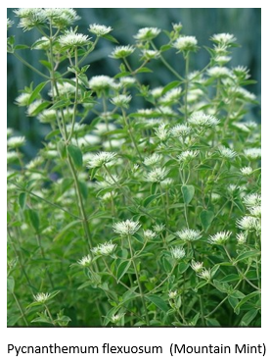
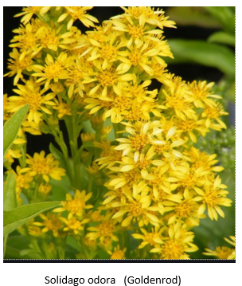
FALL BLOOMING POLLINATOR FRIENDLY PLANTS

Slide 8
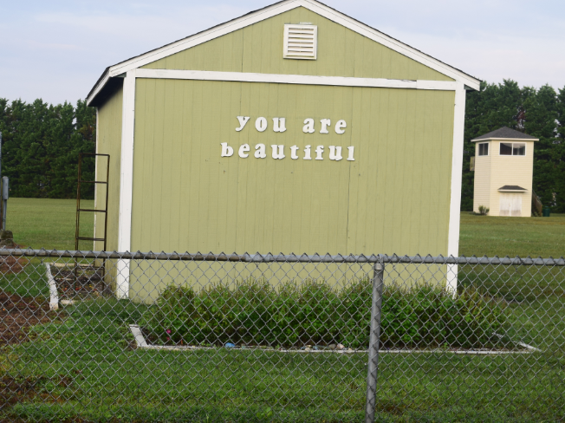
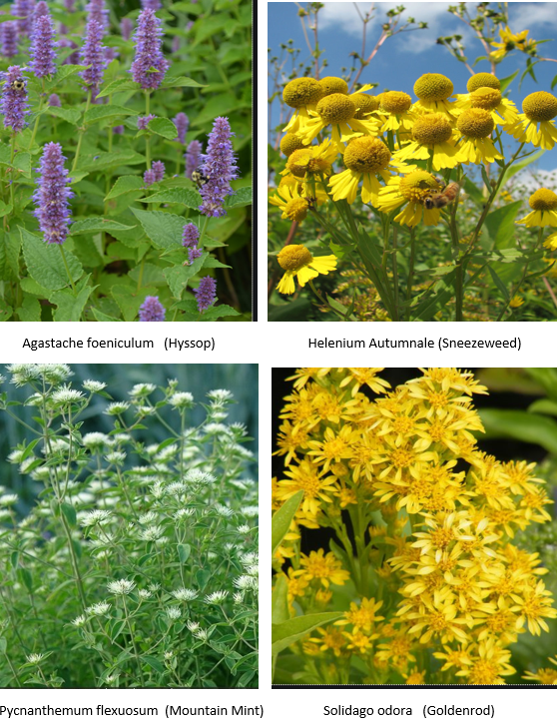
SITE ONE
ESTABLISHMENT AREA

Slide 9
SITE 2

Slide 10
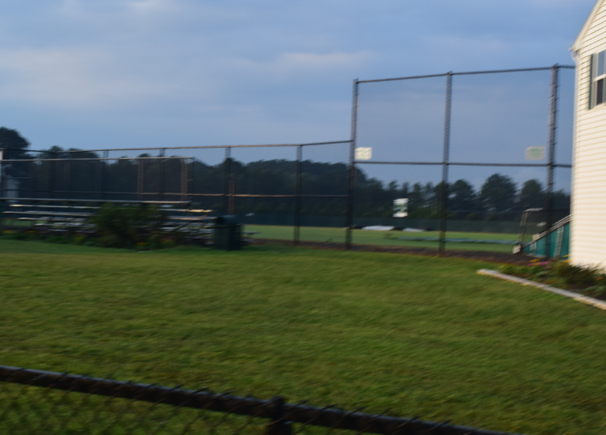
SITE 3

Slide 11
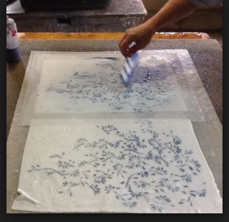
EDUCATION LINKS
POLLINATOR PLANTS
Art and Photography

Slide 12
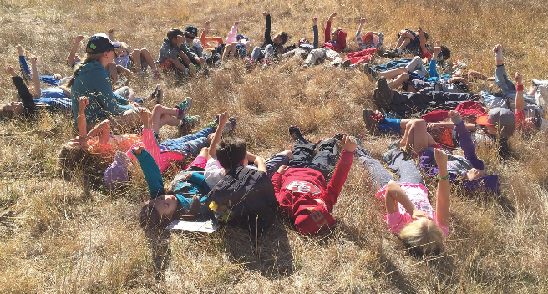
Observations
Research
Connections

